Slide 1




NEXT GEN EMPLOYABILITY PROGRAM
Creating a future-ready workforce
Student details
College Name
Student Name :K.C.Asmitha
Student ID :110321104022
GRT Institue of engineering and technology- Thiruthani

Slide 2

CAPSTONE PROJECT SHOWCASE
Project Title
MUSIC WEB APPLICATION USING DJANGO FRAMEWORK
Abstract | Problem Statement | Project Overview | Proposed Solution | Technology Used | Modelling & Results | Conclusion

Slide 3
Abstract: This capstone project revolves around the development of a music web application using the Django framework. The aim is to create a platform that enables users to discover, stream, and interact with music content seamlessly. Through this project, we address the need for a user-friendly and feature-rich music platform that caters to the diverse preferences of music enthusiasts.

Slide 4
Problem Statement: The current music streaming platforms often lack certain features or have cumbersome interfaces, making the user experience less than optimal. Moreover, some users may face difficulties in discovering new music tailored to their tastes. This project aims to tackle these issues by providing a solution that offers an intuitive interface and robust features for music exploration and consumption

Slide 5
Project Overview: The music web application developed in this capstone project utilizes the Django framework to create a dynamic and responsive platform. Users can register, search for songs, create playlists, follow artists, and interact with other users through comments and likes. The application integrates various functionalities to enhance the user experience, including recommendation algorithms, social features, and a polished user interface.

Slide 6
Proposed Solution: To address the challenges outlined in the problem statement, our project proposes several solutions: 1. Intuitive User Interface: Designing a user-friendly interface that facilitates easy navigation and seamless interaction with music content. 2. Advanced Recommendation System: Implementing algorithms to suggest personalized music recommendations based on user preferences and listening history. 3. Social Integration: Allowing users to connect with friends, share playlists, and discover new music through social interactions. 4. Robust Backend Infrastructure: Utilizing Django's powerful backend capabilities to ensure scalability, security, and efficient data management.
.

Slide 7
Proposed Solution key points:
>Intuitive user interface
>advanced recommendation system
>social integration
>robust backend infrastructure
>continuos improvement and feedback mechanisms

Slide 8
TECHNOLOGIES USED:
- Django Framework: For backend development, routing, and database management.
- HTML, CSS, JavaScript: For frontend development and creating a responsive user interface.
- SQLite or PostgreSQL: For database management, depending on project requirements.
- Django REST Framework: For building RESTful APIs to enable interaction with frontend components.
- Third-party APIs: Integration with music databases or services for fetching song information and metadata.

Slide 9


Technology Used
Front-end
Back-end

Slide 10
Modelling & Results: The application's data model includes entities such as Users, Songs, Playlists, Artists, and Interactions. We implement recommendation algorithms based on collaborative filtering and content-based filtering techniques to provide personalized music suggestions. User engagement metrics, such as time spent on the platform, number of interactions, and playlist creation frequency, are tracked to evaluate the effectiveness of the recommendation system and overall user satisfaction.

Slide 11
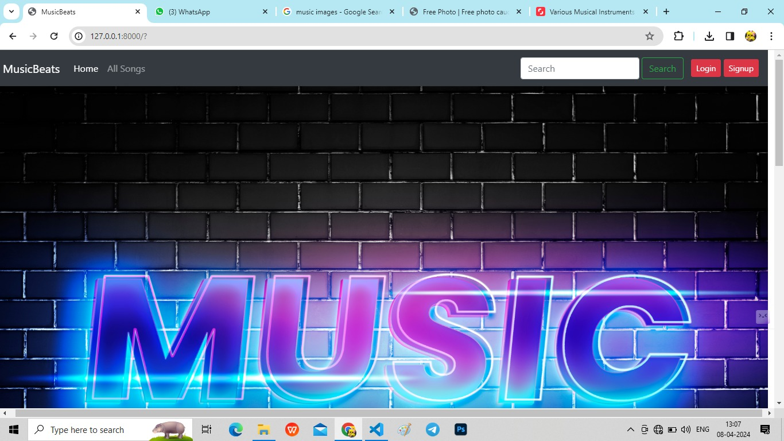
Homepage (carousel-1)

Slide 12
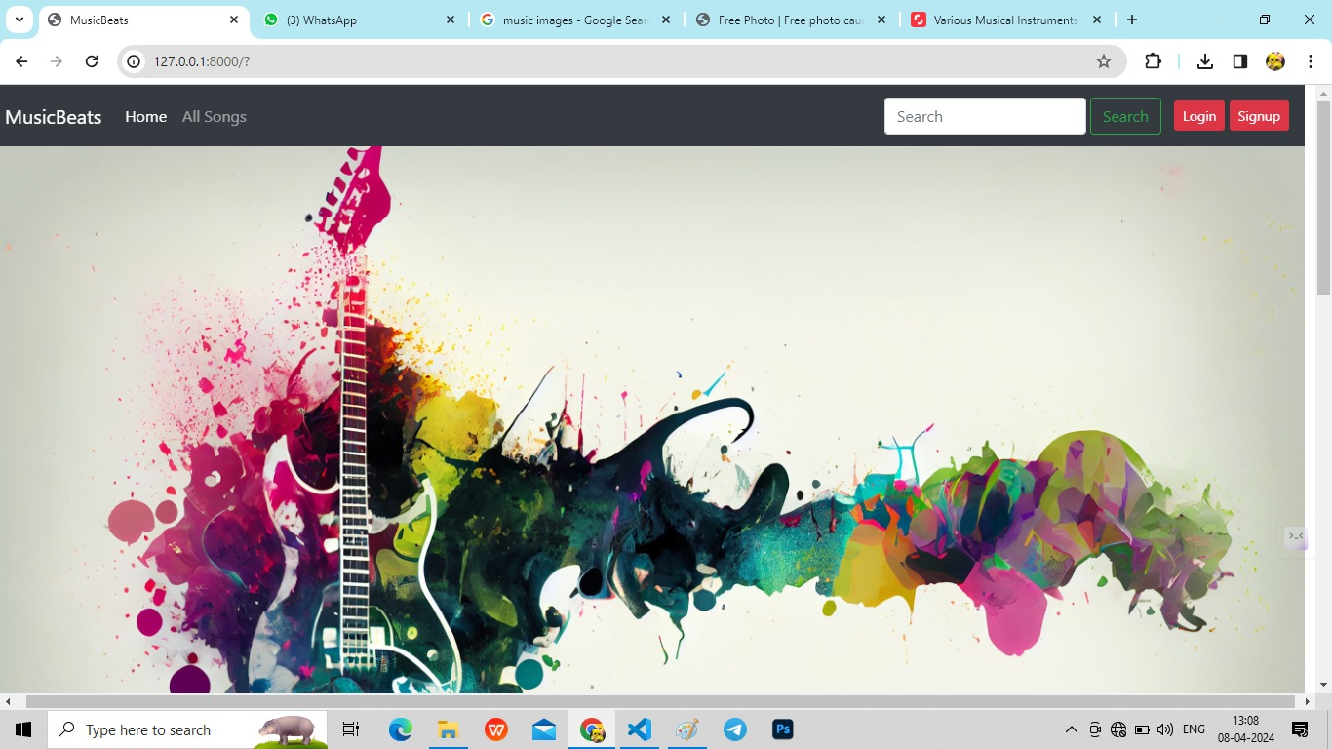
Home page(carousel)-2

Slide 13
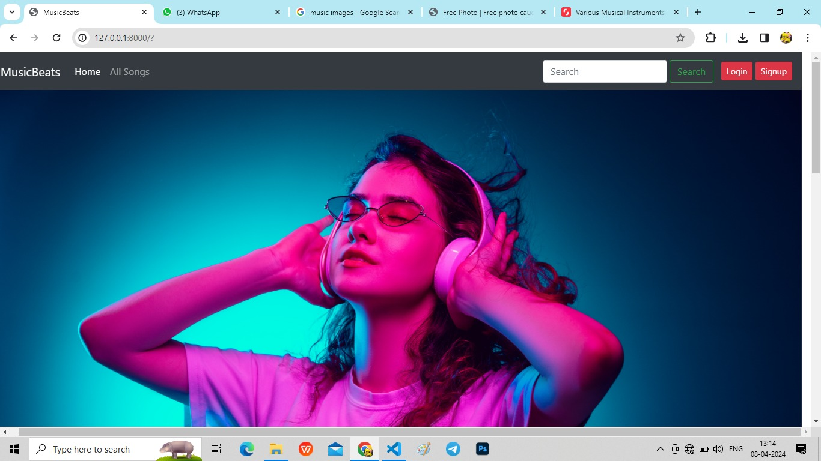
Homepage (carousel-3)

Slide 14
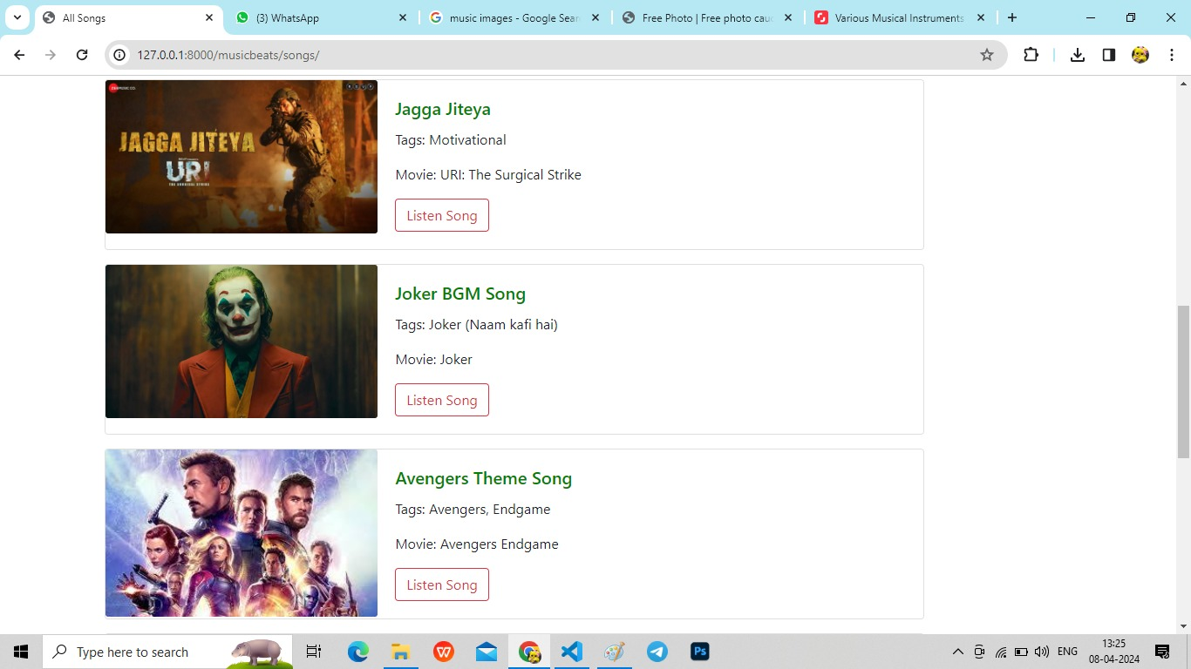
Main-page (songs set)

Slide 15
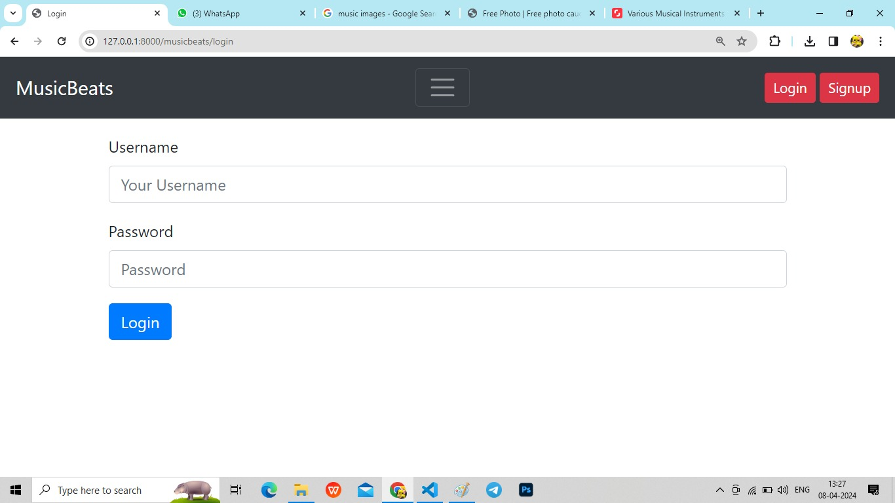
Login-Page

Slide 16
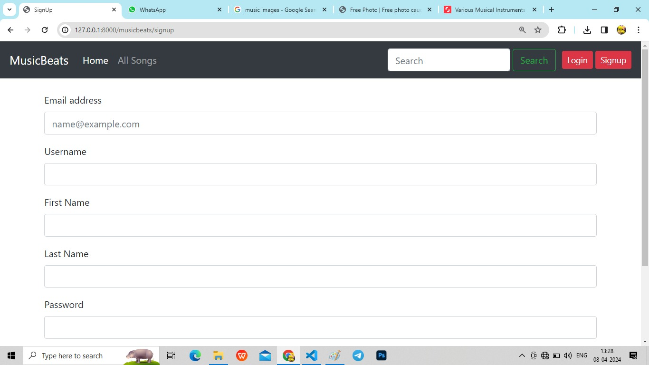
Sign.in-Page

Slide 17
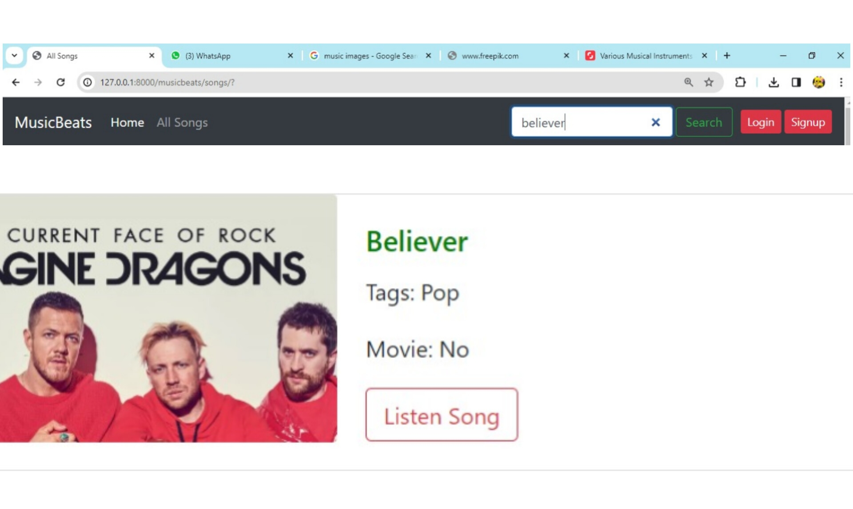
search-Page

Slide 18
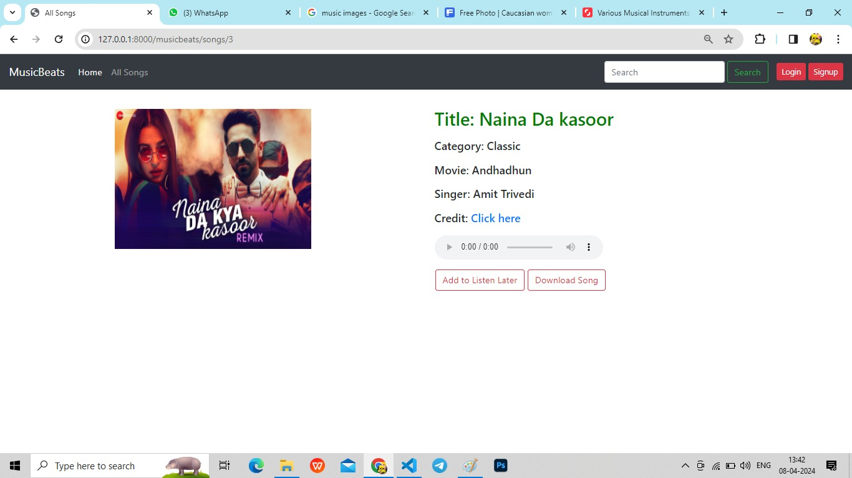
Song page (playing)

Slide 19
Future Enhancements: >personalized playlist >live streaming and events >integrations with music API’s >podcasts and audio content >Localized content and languages >enhanced social features >gamification and rewards >Accesibility improvements >monetization stratergies >continuous performance optimizations

Slide 20
Conclusion: In conclusion, this capstone project demonstrates the development of a comprehensive music web application using the Django framework. By addressing the shortcomings of existing platforms and incorporating innovative features, we aim to provide users with a satisfying and enriching music discovery experience. The project underscores the versatility and capabilities of Django for building modern web applications and lays the foundation for future enhancements and iterations.

Slide 21
Thank You!
Notes:
Thank You !!

